Slide 1
計算機概論實習
Week4(2020/10/6)
LOOP
Lab: EC 118
Teaching Assistant :
陳作源 russchen.cs08g@nctu.edu.tw
陳彥銨 my91015.cs08g@nctu.edu.tw
鄭智仁 king601012003.cs08g@nctu.edu.tw

Slide 2
for

Slide 3
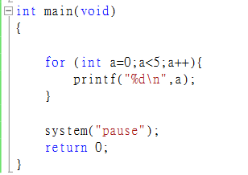
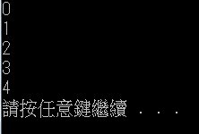
For loop
for( initialization；condition；increment )
{
statement(s)；
}
initialization
false
other statements
condition
true
code block
increment

Slide 4
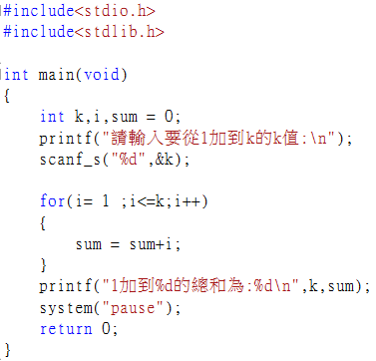
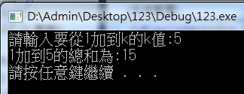
Example

Slide 5
Compound Assignment Operators
Compound Assignment operator | Sample expression | Assign
Assume：a=12
+= | a += 7 | a = 19
-= | a -= 4 | a = 8
*= | a *= 5 | a = 60
/= | a /= 3 | a = 4
%= | a %= 9 | a = 3
Can be recognized as adding, subtracting, multiplying and dividing to itself

Slide 6
Nested for Loop
initialization1
a=0
other statements
condition1
a<10
false
true
initialization 2
b=0
b<5
false
conditio2
increment 1
a++
true
code block
increment 2
b++

Slide 7
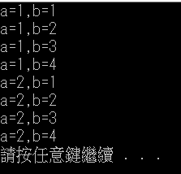
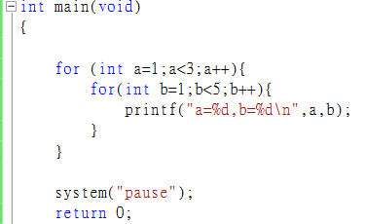
Nested for Loop
for(initialization1；condition1；increment1)
{
for(initialization1 ；condition2；increment2)
{
statement(s)；
}
}

Slide 8
while & do while

Slide 9
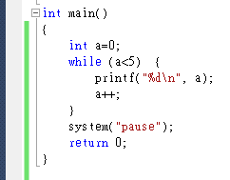
while
initialization
Set initial value of loop
while(condition)
{
statement(s);
increment;
}
false
other statements
condition
true
code block
increment

Slide 10
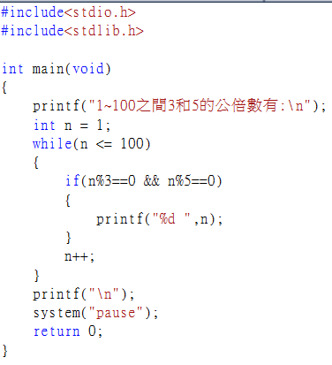
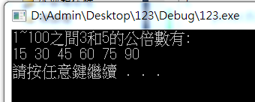
Example
What are the common multiple of 3 and 5 in the range of 1~100?

Slide 11

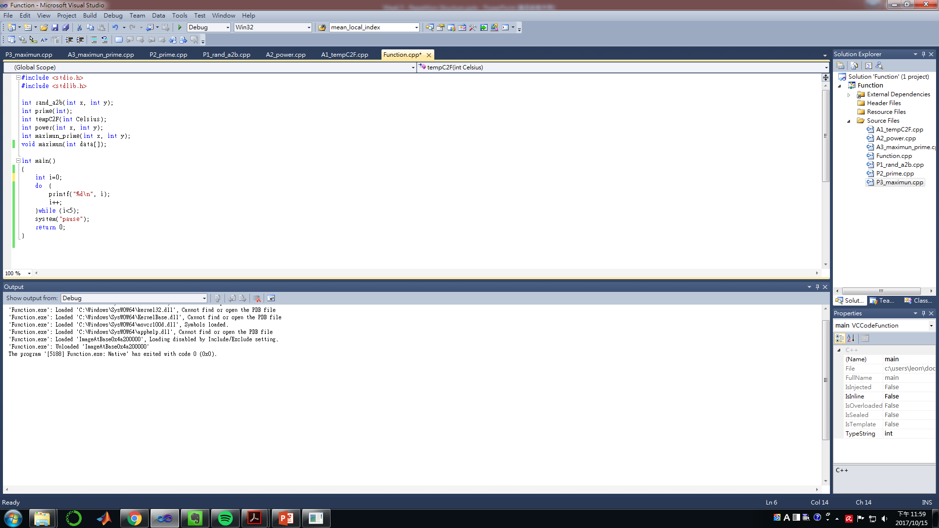
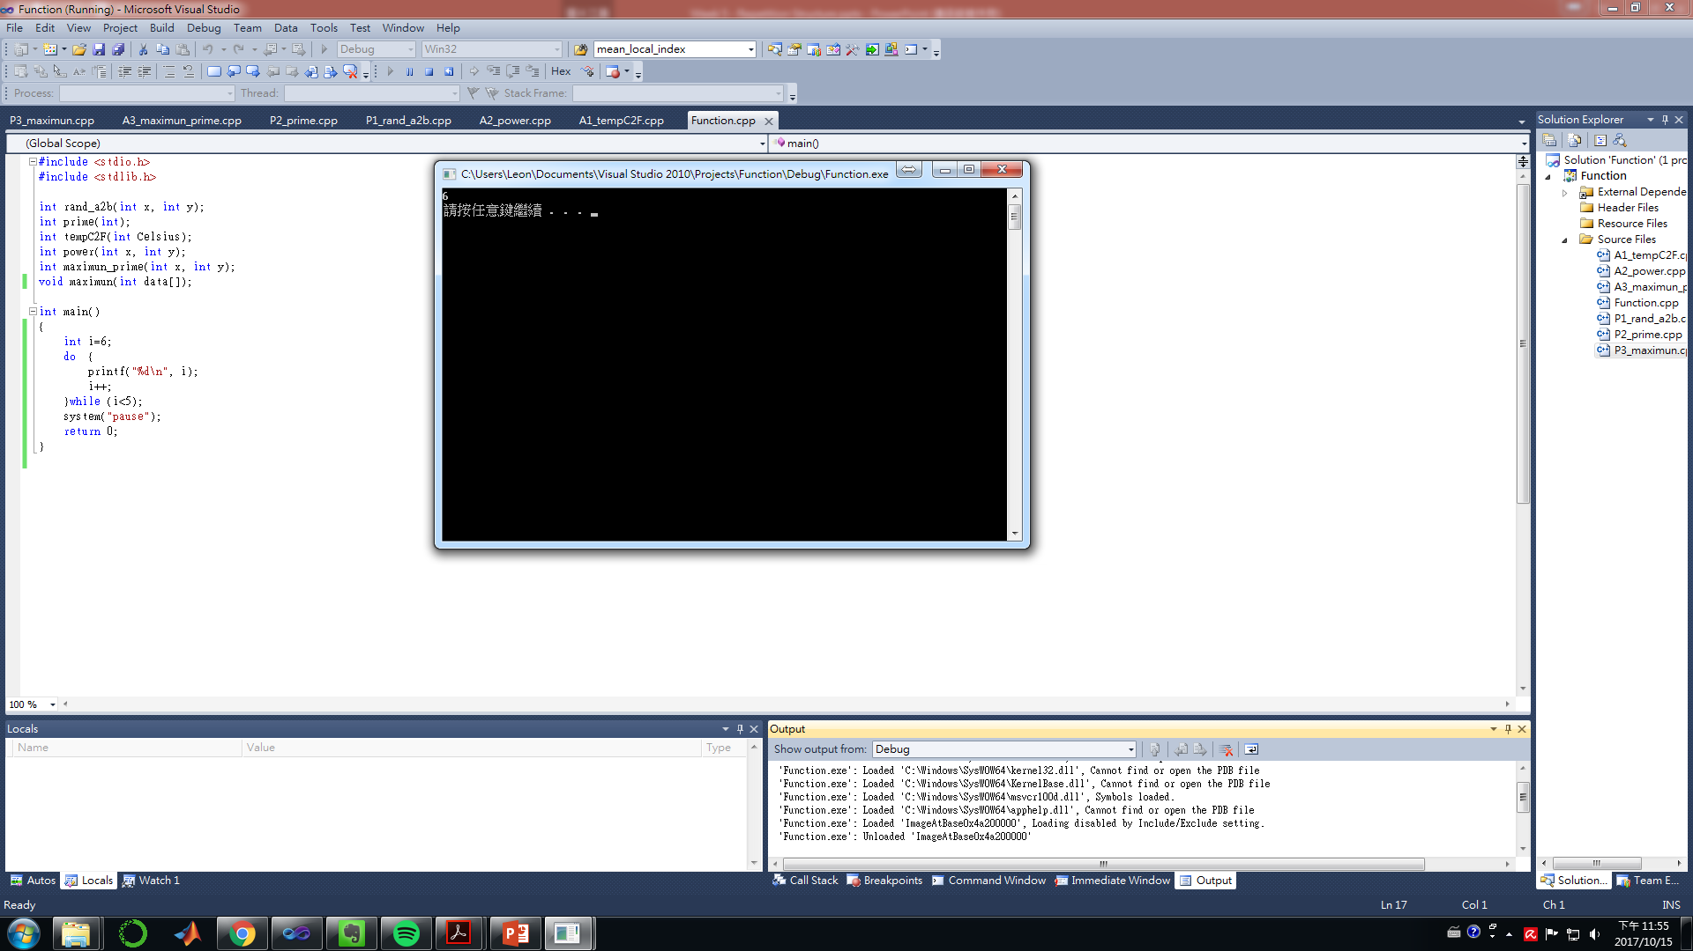
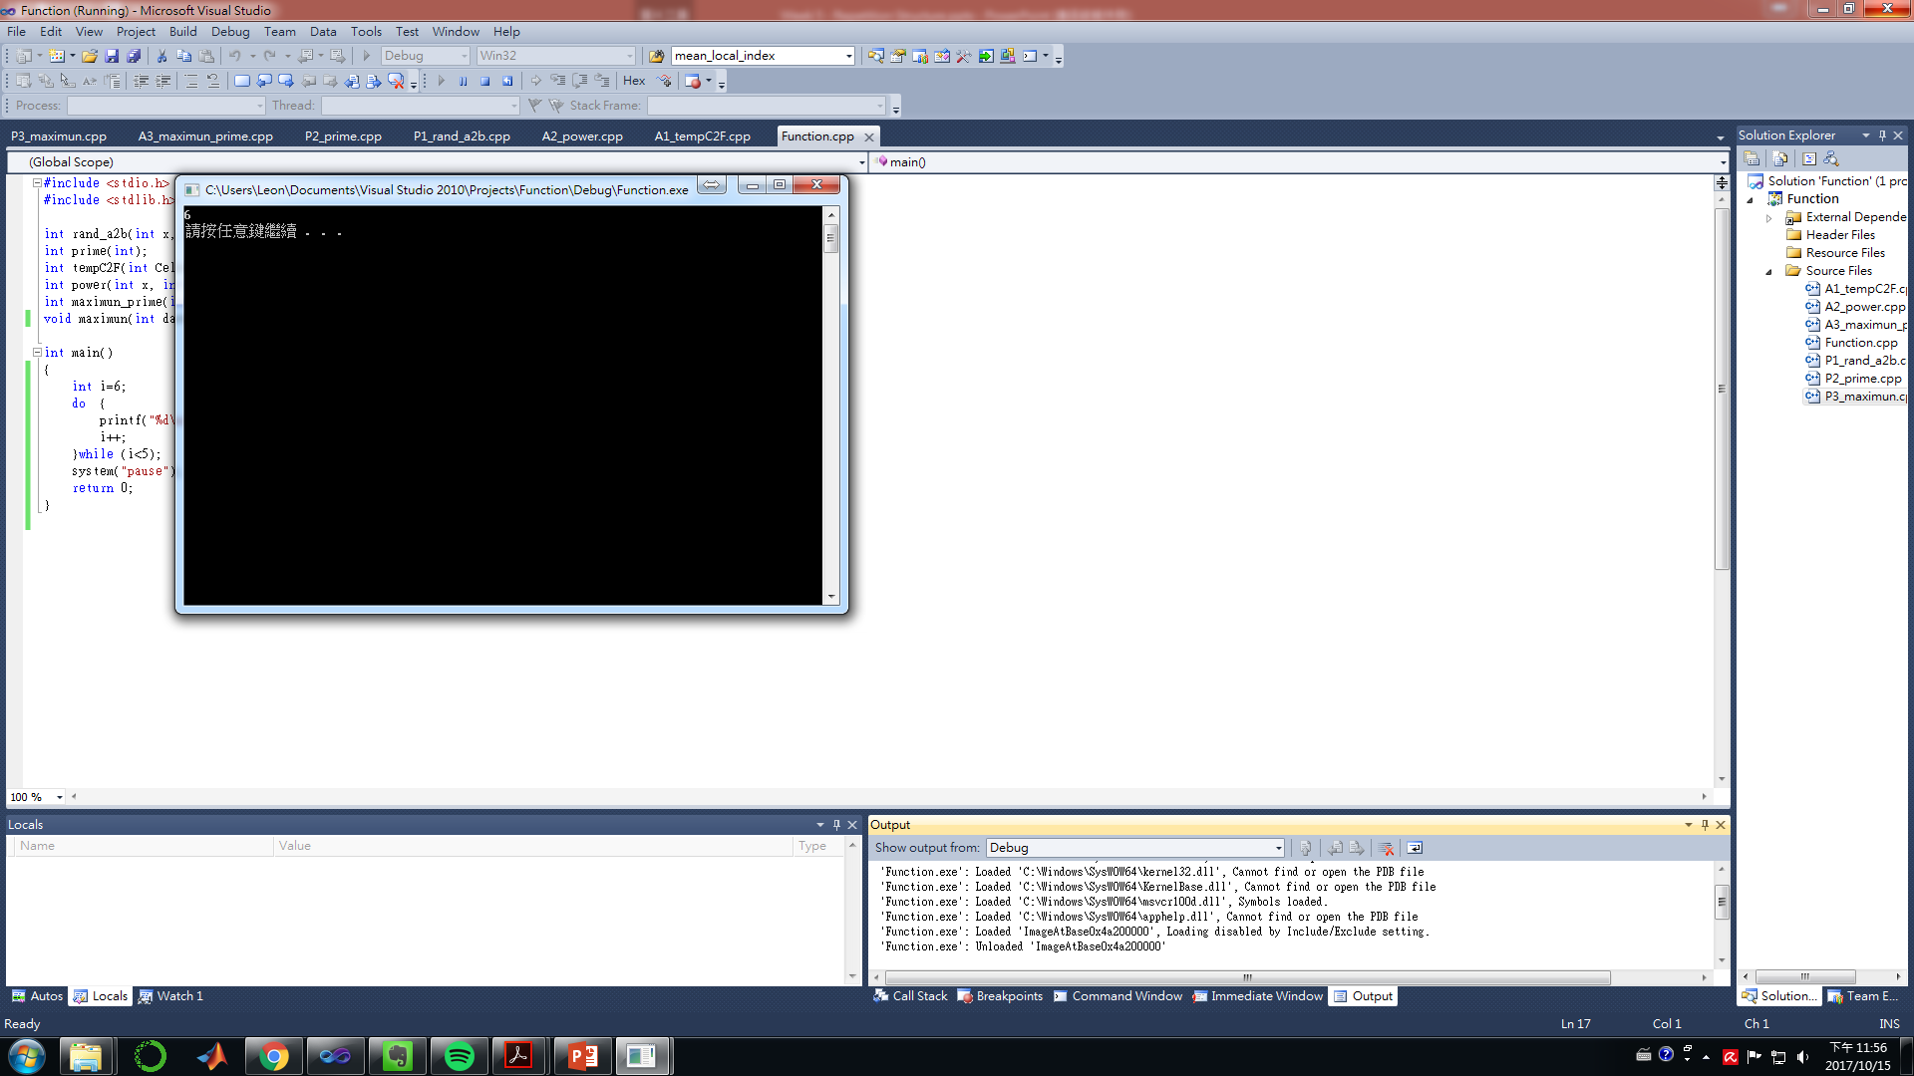
do while
initialization
Set initial value of loop
do{
statement(s);
increment
}while(condition);
code block
increment
true
condition
false
other statements
Even if the judgment condition is not met, it will be executed at least once

Slide 12
break
for(initialization; condition; increment)
{
Statement 1;
Statement 2;
…
break;
…
statement n
}
If the break statement is executed, the statement in this block will not be executed.
Moreover, the for loop will terminate immediately.
…

Slide 13
continue
for(initialization; condition; increment)
{
statement 1;
statement 2;
…
continue;
…
statement n
}
If the continue statement is executed, the statement in this block will not be executed.
But it will continue to execute the next loop.

Slide 14
infinite loop
Digital 1
while(1)
{
statement(s);
if(condition)
{
statement;
break;
}
}
Continuous execution loop
Do not jump out of the loop until the condition is satisfied

Slide 15
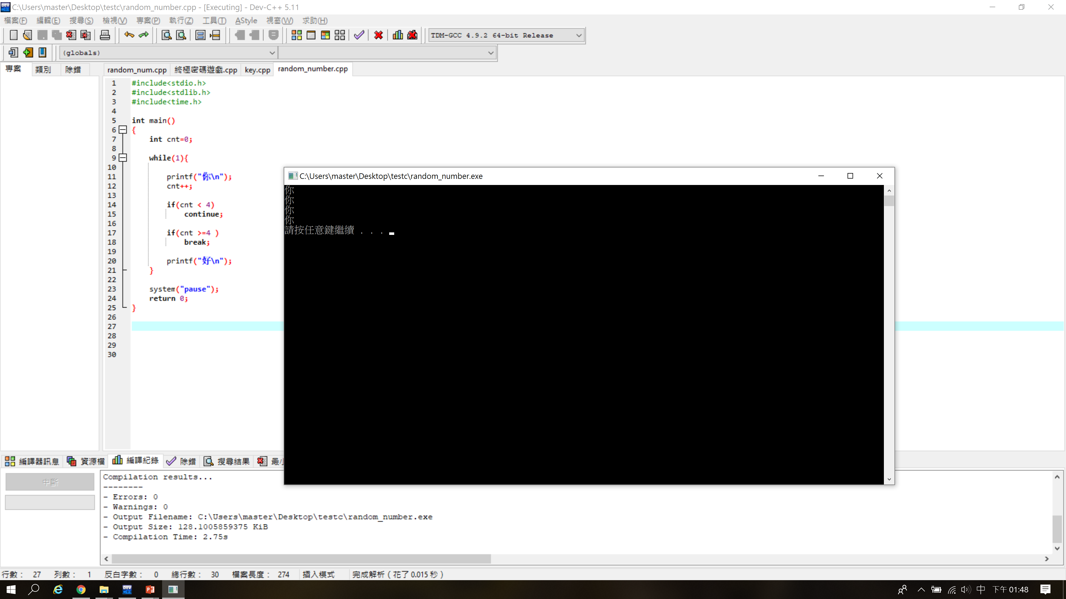
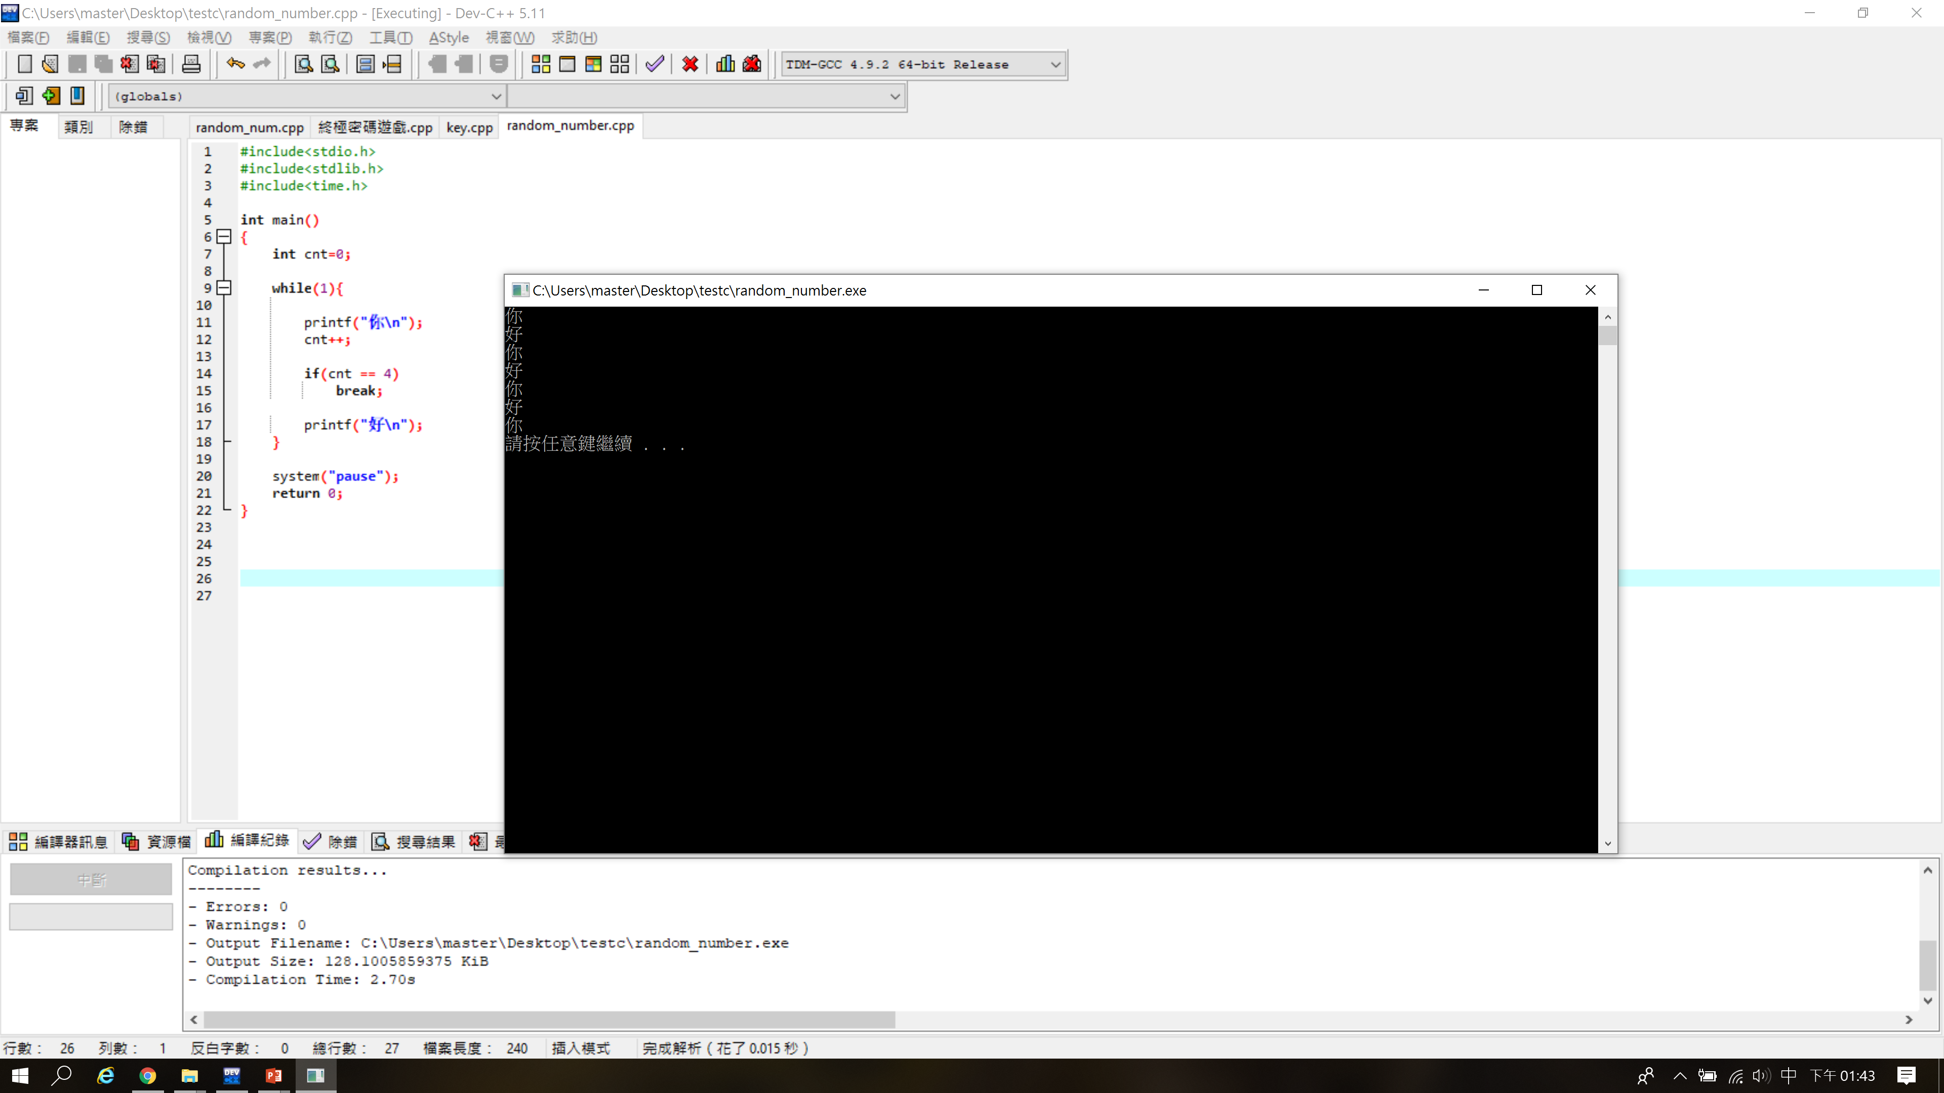
Example

Slide 16
GENERATE RANDOM NUMBER

Slide 17
Generate random number
Generate an int type random number in the range [0,n)
For example : 0 , 3 , 9 , 7 , 5 , 2 , 1 , 8 , 5 …
Generate an float type random number in the range [0,n)
For example : 0.123 , 0.567 , 0.878 , 0.800 , 0.987

Slide 18
Random number generator : rand()
Features
1. Generate an integer value between [0, RAND_MAX]
2. RAND_MAX varies by computer byte
How to generate an int type random number between [0,n)?
code :
int num1 = rand()%n;
How to generate an float type random number between [0,n)?
code :
float num2 = (float)rand()/(RAND_MAX+1.0);

Slide 19
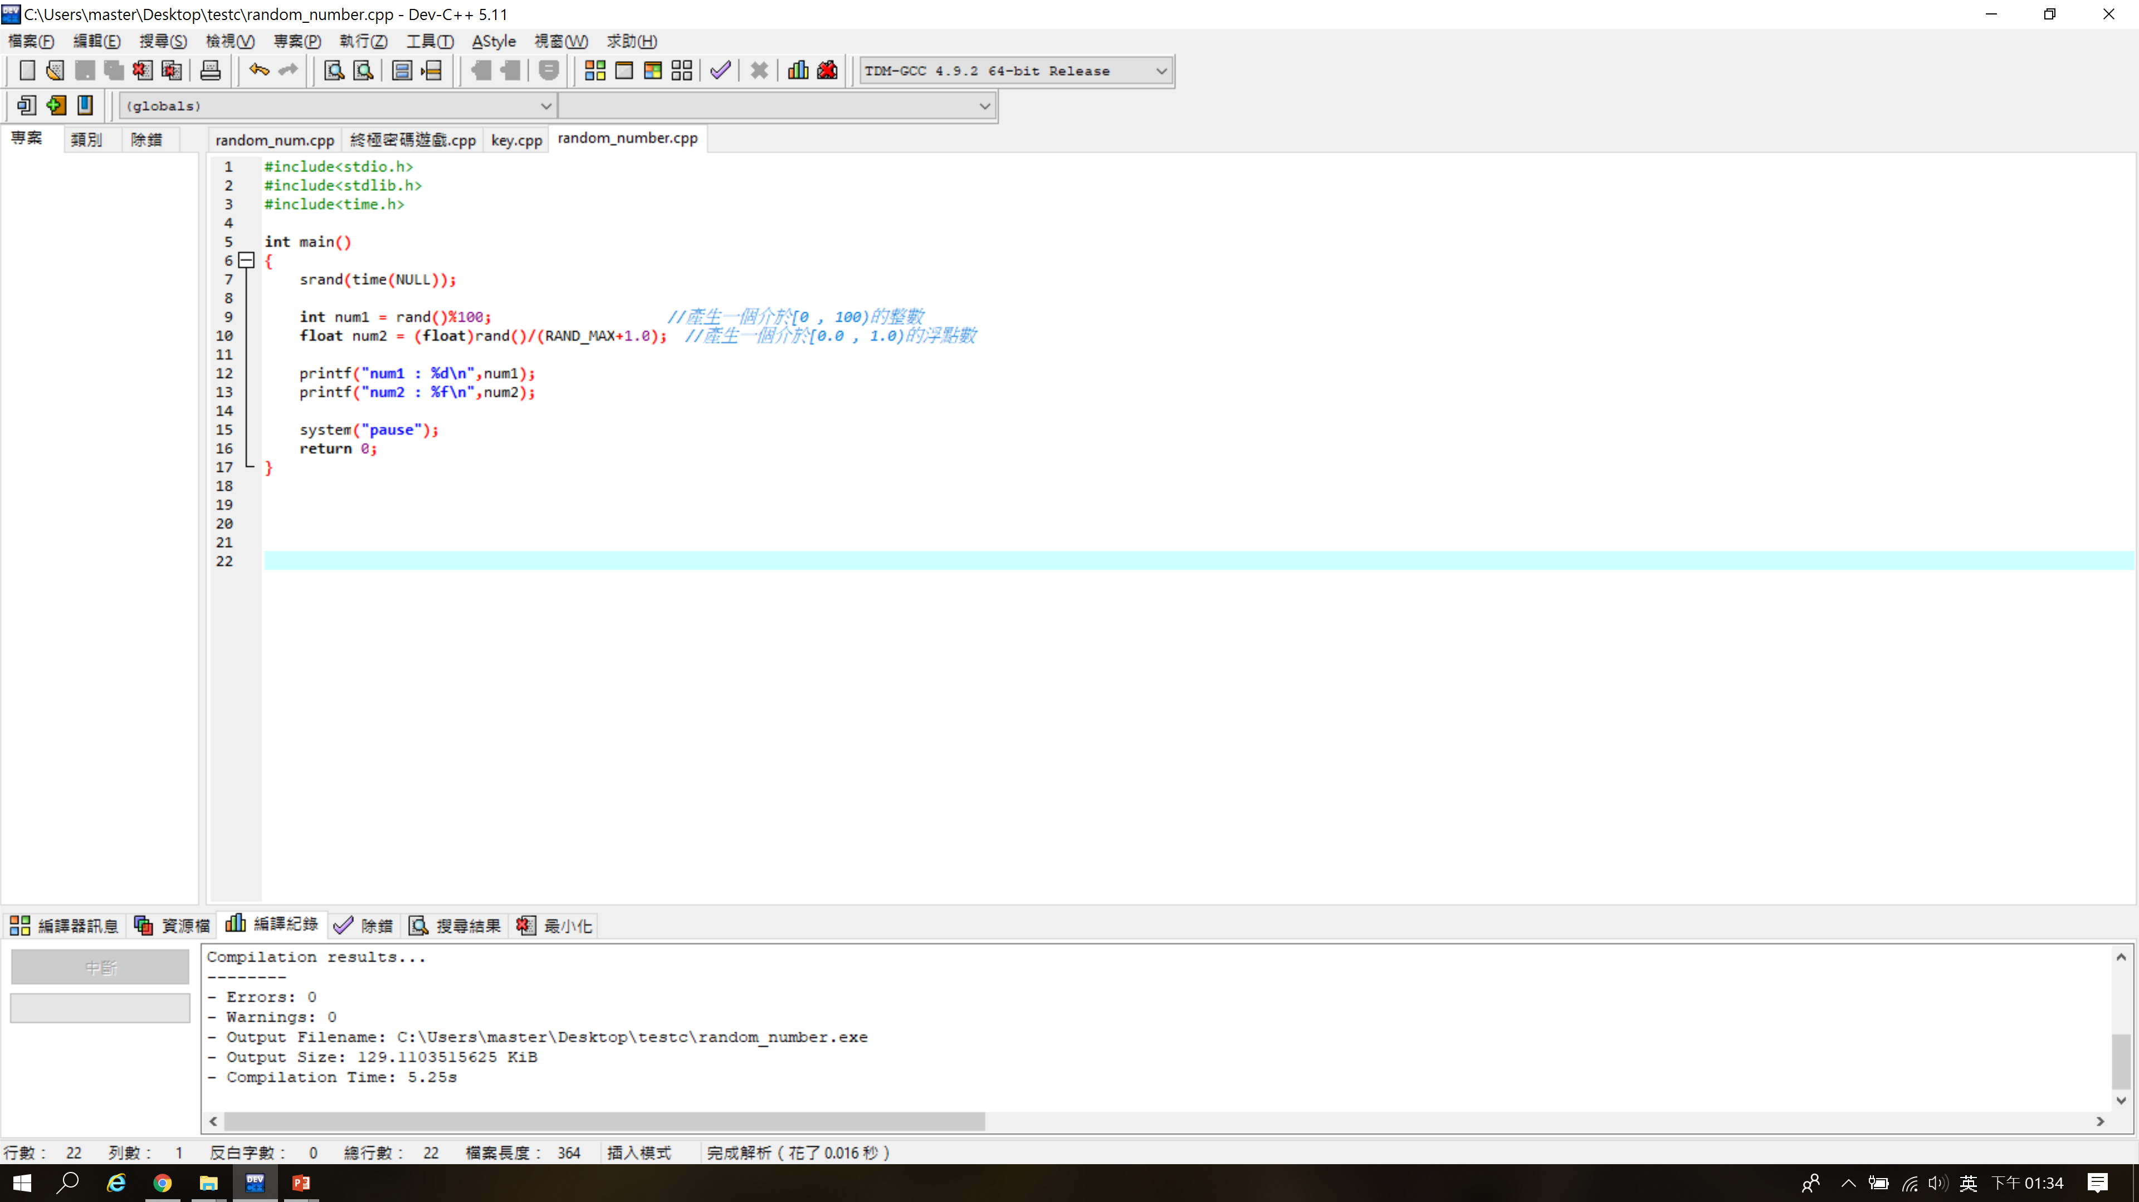
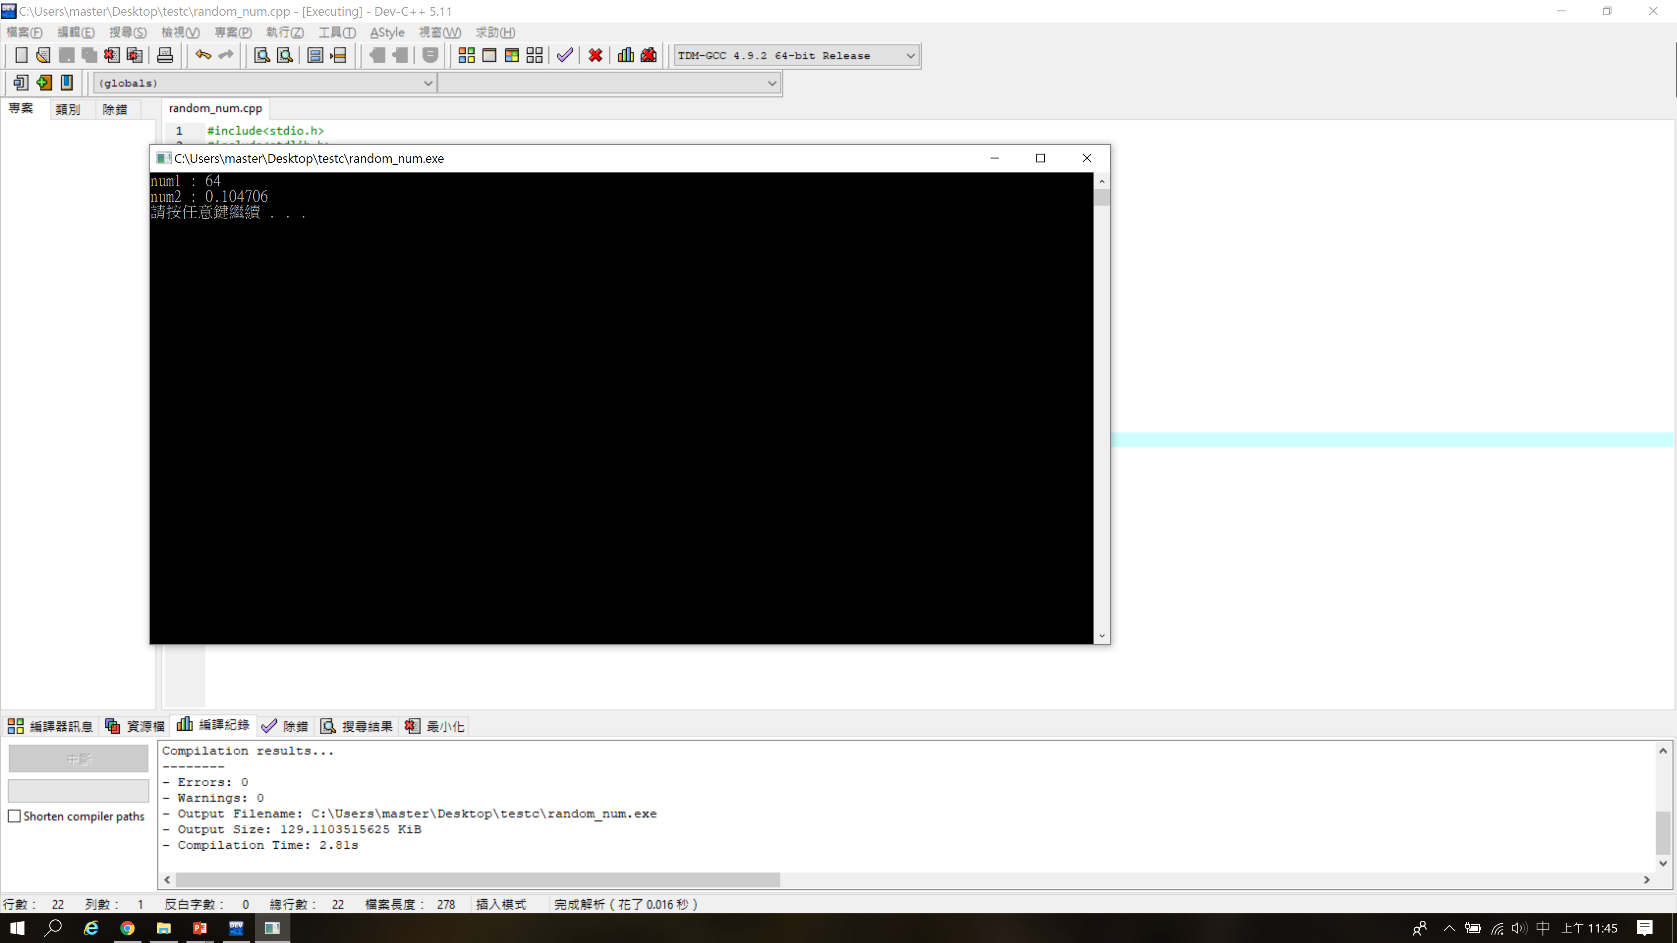
Example
seed : Each time the program is executed, the random number generated is different from the previous time the program is executed

Slide 20
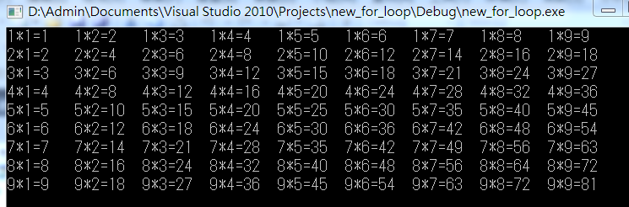
Exercise 1
Please use 2 layers of for loop and printf to print out the multiplication table

Slide 21
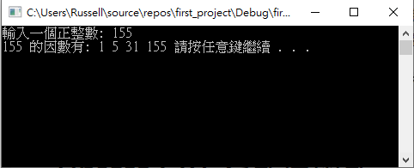
Exercise 2
Use for loop to find all factors of a positive integer

Slide 22
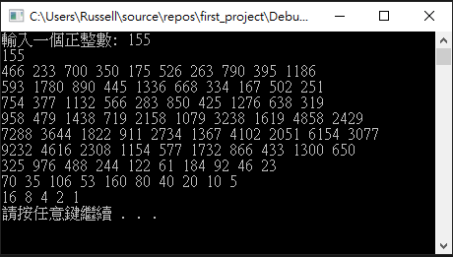
Exercise 3
The 3n + 1 problem
step 1: input n
step 2: print n
step 3: n=3*n+1 and go to step 2, n is odd
end , n=1
n=n/2 and go to step 2 , else

Slide 23
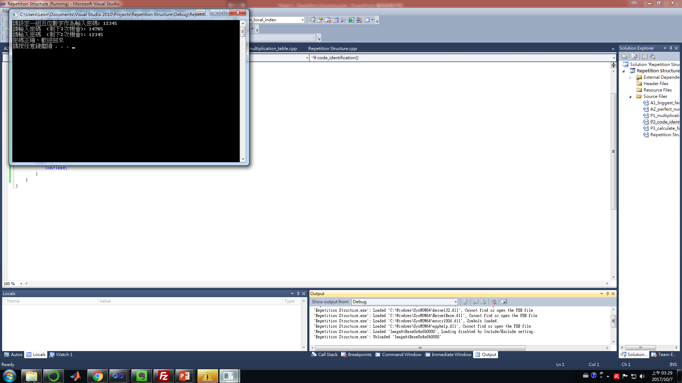
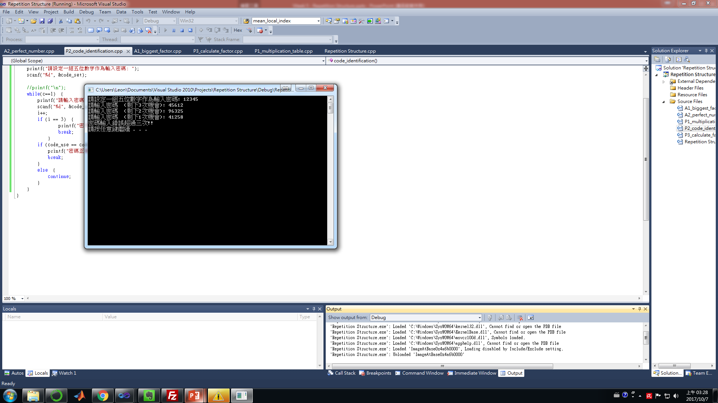
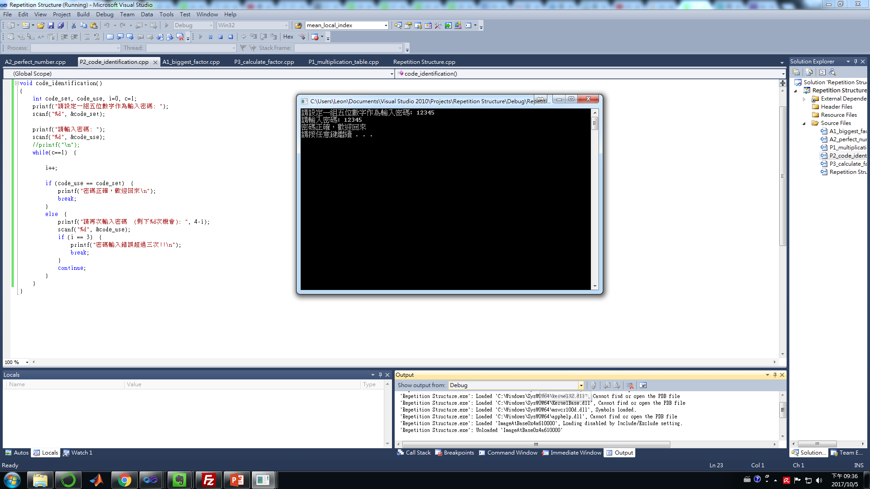
Exercise 4
Write a program that uses While and break statements to write 5-digit password authentication. The program must meet the following conditions
If you make a mistake, the program will print out "請輸入密碼 (剩下次數):"
If the three entries are wrong, the program will print out "密碼輸入錯誤超過三次!!" and the program execution will end.
If the password is correct, it will print out "Password is correct, welcome back"

Slide 24
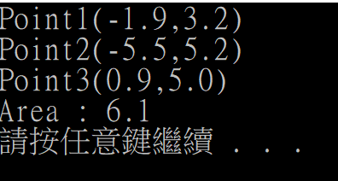
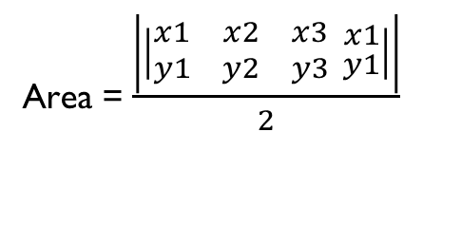
Exercise 5
Please use a random number generator to generate three coordinate points. The x and y values of each coordinate point must be floating-point numbers and the range is between (-6.0, 7.0). Finally, use the following formula to calculate the three points Triangle area
Note: Floating point number is output to the first decimal point
Area = $\frac{\left|\left|\begin{matrix}x1 & x2 & x3 \\ y1 & y2 & y3 \end{matrix}\begin{aligned}x1 \\ y1\end{aligned}\right|\right|}{2}$

